Slide 1
Combinational Logic
Chapter 4c
Imran Siddiqi
imran.siddiqi@mcs.edu.pk
Computer Science Department
College of Telecommunication Engineering
National University of Sciences and Technology

Slide 2
Contents
BCD Adder
Binary Multiplier
Magnitude Comparator

Slide 3
BCD Adder
Recal: Conversion & Coding
(12)₁₀
1100
Coding
(using BCD code
for each digit)
00010010
Conversion

Slide 4
BCD Adder
Design a circuit that calculates the Arithmetic addition of two decimal digits.
9
+
3
1
2
carry
Maximum sum is 9+9 + 1 = 19
Max digit
Carry from previous digits

Slide 5
BCD Adder
Full adder ➔ (1+1) Bit + 1 Carry= 3 bits
BCD➔(4+4) Bits + 1 Carry= 9 bits input
Max output is 9+9+1=19
Use 4 bit binary adder
  Input 2 BCD numbers
  Sum will be in binary form
  Output binary number from 0 to 19
  AIM: Convert Binary back to BCD

Slide 6
BCD Adder
BCD Sum
Number | C | S8 | S4 | S2 | S1
0 | 0 | 0 | 0 | 0 | 0
1 | 0 | 0 | 0 | 0 | 1
2 | 0 | 0 | 0 | 1 | 0
3 | 0 | 0 | 0 | 1 | 1
4 | 0 | 0 | 1 | 0 | 0
5 | 0 | 0 | 1 | 0 | 1
6 | 0 | 0 | 1 | 1 | 0
7 | 0 | 0 | 1 | 1 | 1
8 | 0 | 1 | 0 | 0 | 0
9 | 0 | 1 | 0 | 0 | 1
Upto 9, the sum of Binary Adder and BCD Adder is same

Slide 7
BCD Adder
BCD Sum
Number | C | S8 | S4 | S2 | S1
10 | 1 | 0 | 0 | 0 | 0
11 | 1 | 0 | 0 | 0 | 1
12 | 1 | 0 | 0 | 1 | 0
13 | 1 | 0 | 0 | 1 | 1
14 | 1 | 0 | 1 | 0 | 0
15 | 1 | 0 | 1 | 0 | 1
16 | 1 | 0 | 1 | 1 | 0
17 | 1 | 0 | 1 | 1 | 1
18 | 1 | 1 | 0 | 0 | 0
19 | 1 | 1 | 0 | 0 | 1

Slide 8
BCD Adder
BCD adder sum
Binary sum
Number
C
S8
S4
S2
S1
K | Z8 | Z4 | Z2 | Z1
0 | 1 | 0 | 1 | 0
0 | 1 | 0 | 1 | 1
0 | 1 | 1 | 0 | 0
0 | 1 | 1 | 0 | 1
0 | 1 | 1 | 1 | 0
0 | 1 | 1 | 1 | 1
1 | 0 | 0 | 0 | 0
1 | 0 | 0 | 0 | 1
1 | 0 | 0 | 1 | 0
1 | 0 | 0 | 1 | 1
10
1
0
0
0
0
11
1
0
0
0
1
12
1
0
0
1
0
13
1
0
0
1
1
14
1
0
1
0
0
15
1
0
1
0
1
16
1
0
1
1
0
17
1
0
1
1
1
18
1
1
0
0
0
19
1
1
0
0
1

Slide 9
BCD Adder
BCD adder sum
Binary sum
Number
C
S8
S4
S2
S1
K | Z8 | Z4 | Z2 | Z1
0 | 1 | 0 | 1 | 0
0 | 1 | 0 | 1 | 1
0 | 1 | 1 | 0 | 0
0 | 1 | 1 | 0 | 1
0 | 1 | 1 | 1 | 0
0 | 1 | 1 | 1 | 1
1 | 0 | 0 | 0 | 0
1 | 0 | 0 | 0 | 1
1 | 0 | 0 | 1 | 0
1 | 0 | 0 | 1 | 1
10
1
0
0
0
0
11
1
0
0
0
1
12
1
0
0
1
0
+6
13
1
0
0
1
1
14
1
0
1
0
0
15
1
0
1
0
1
16
1
0
1
1
0
17
1
0
1
1
1
18
1
1
0
0
0
19
1
1
0
0
1

Slide 10
BCD Adder
If sum is up to 9
  Use the regular Adder.
If the sum > 9
  Use the regular adder and add 6 to the result

Slide 11
BCD Adder
Binary Sum |  |  |  |  | BCD Sum |  |  |  |  | Dec
K | Z8 | Z4 | Z2 | Z1 | C | S8 | S4 | S2 | S1
0 | 0 | 0 | 0 | 0 | 0 | 0 | 0 | 0 | 0 | 0
0 | 0 | 0 | 0 | 1 | 0 | 0 | 0 | 0 | 1 | 1
0 | 0 | 0 | 1 | 0 | 0 | 0 | 0 | 1 | 0 | 2
0 | 0 | 0 | 1 | 1 | 0 | 0 | 0 | 1 | 1 | 3
0 | 0 | 1 | 0 | 0 | 0 | 0 | 1 | 0 | 0 | 4
0 | 0 | 1 | 0 | 1 | 0 | 0 | 1 | 0 | 1 | 5
0 | 0 | 1 | 1 | 0 | 0 | 0 | 1 | 1 | 0 | 6
0 | 0 | 1 | 1 | 1 | 0 | 0 | 1 | 1 | 1 | 7
0 | 1 | 0 | 0 | 0 | 0 | 1 | 0 | 0 | 0 | 8
0 | 1 | 0 | 0 | 1 | 0 | 1 | 0 | 0 | 1 | 9
0 | 1 | 0 | 1 | 0 | 1 | 0 | 0 | 0 | 0 | 10
0 | 1 | 0 | 1 | 1 | 1 | 0 | 0 | 0 | 1 | 11
0 | 1 | 1 | 0 | 0 | 1 | 0 | 0 | 1 | 0 | 12
0 | 1 | 1 | 0 | 1 | 1 | 0 | 0 | 1 | 1 | 13
0 | 1 | 1 | 1 | 0 | 1 | 0 | 1 | 0 | 0 | 14
0 | 1 | 1 | 1 | 1 | 1 | 0 | 1 | 0 | 1 | 15
1 | 0 | 0 | 0 | 0 | 1 | 0 | 1 | 1 | 0 | 16
1 | 0 | 0 | 0 | 1 | 1 | 0 | 1 | 1 | 1 | 17
1 | 0 | 0 | 1 | 0 | 1 | 1 | 0 | 0 | 0 | 18
1 | 0 | 0 | 1 | 1 | 1 | 1 | 0 | 0 | 1 | 19
If sum exceeds binary 9 then represent it as two separate binary numbers
Add binary 6(0110)

Slide 12
BCD Adder – When is the Sum > 9
N | K | Z8 | Z4 | Z2 | Z1
0 | 0 | 0 | 0 | 0 | 0
1 | 0 | 0 | 0 | 0 | 1
2 | 0 | 0 | 0 | 1 | 0
3 | 0 | 0 | 0 | 1 | 1
4 | 0 | 0 | 1 | 0 | 0
5 | 0 | 0 | 1 | 0 | 1
6 | 0 | 0 | 1 | 1 | 0
7 | 0 | 0 | 1 | 1 | 1
8 | 0 | 1 | 0 | 0 | 0
9 | 0 | 1 | 0 | 0 | 1
Binary sum
Number
K
Z8
Z4
Z2
Z1
10
0
1
0
1
0
11
0
1
0
1
1
12
0
1
1
0
0
C = K +
13
0
1
1
0
1
14
0
1
1
1
0
15
0
1
1
1
1
16
1
0
0
0
0
17
1
0
0
0
1
18
1
0
0
1
0
19
1
0
0
1
1

Slide 13
BCD Adder – When is the Sum > 9
N | K | Z8 | Z4 | Z2 | Z1
0 | 0 | 0 | 0 | 0 | 0
1 | 0 | 0 | 0 | 0 | 1
2 | 0 | 0 | 0 | 1 | 0
3 | 0 | 0 | 0 | 1 | 1
4 | 0 | 0 | 1 | 0 | 0
5 | 0 | 0 | 1 | 0 | 1
6 | 0 | 0 | 1 | 1 | 0
7 | 0 | 0 | 1 | 1 | 1
8 | 0 | 1 | 0 | 0 | 0
9 | 0 | 1 | 0 | 0 | 1
Binary sum
Number
K
Z8
Z4
Z2
Z1
10
0
1
0
1
0
11
0
1
0
1
1
12
0
1
1
0
0
13
0
1
1
0
1
14
0
1
1
1
0
C = K + Z8*Z4+
15
0
1
1
1
1
16
1
0
0
0
0
17
1
0
0
0
1
18
1
0
0
1
0
19
1
0
0
1
1

Slide 14
BCD Adder – When is the Sum > 9
N | K | Z8 | Z4 | Z2 | Z1
0 | 0 | 0 | 0 | 0 | 0
1 | 0 | 0 | 0 | 0 | 1
2 | 0 | 0 | 0 | 1 | 0
3 | 0 | 0 | 0 | 1 | 1
4 | 0 | 0 | 1 | 0 | 0
5 | 0 | 0 | 1 | 0 | 1
6 | 0 | 0 | 1 | 1 | 0
7 | 0 | 0 | 1 | 1 | 1
8 | 0 | 1 | 0 | 0 | 0
9 | 0 | 1 | 0 | 0 | 1
Binary sum
Number
K
Z8
Z4
Z2
Z1
10
0
1
0
1
0
11
0
1
0
1
1
12
0
1
1
0
0
13
0
1
1
0
1
C = K + Z8*Z4+
Z8*Z2
14
0
1
1
1
0
15
0
1
1
1
1
16
1
0
0
0
0
17
1
0
0
0
1
18
1
0
0
1
0
19
1
0
0
1
1

Slide 15
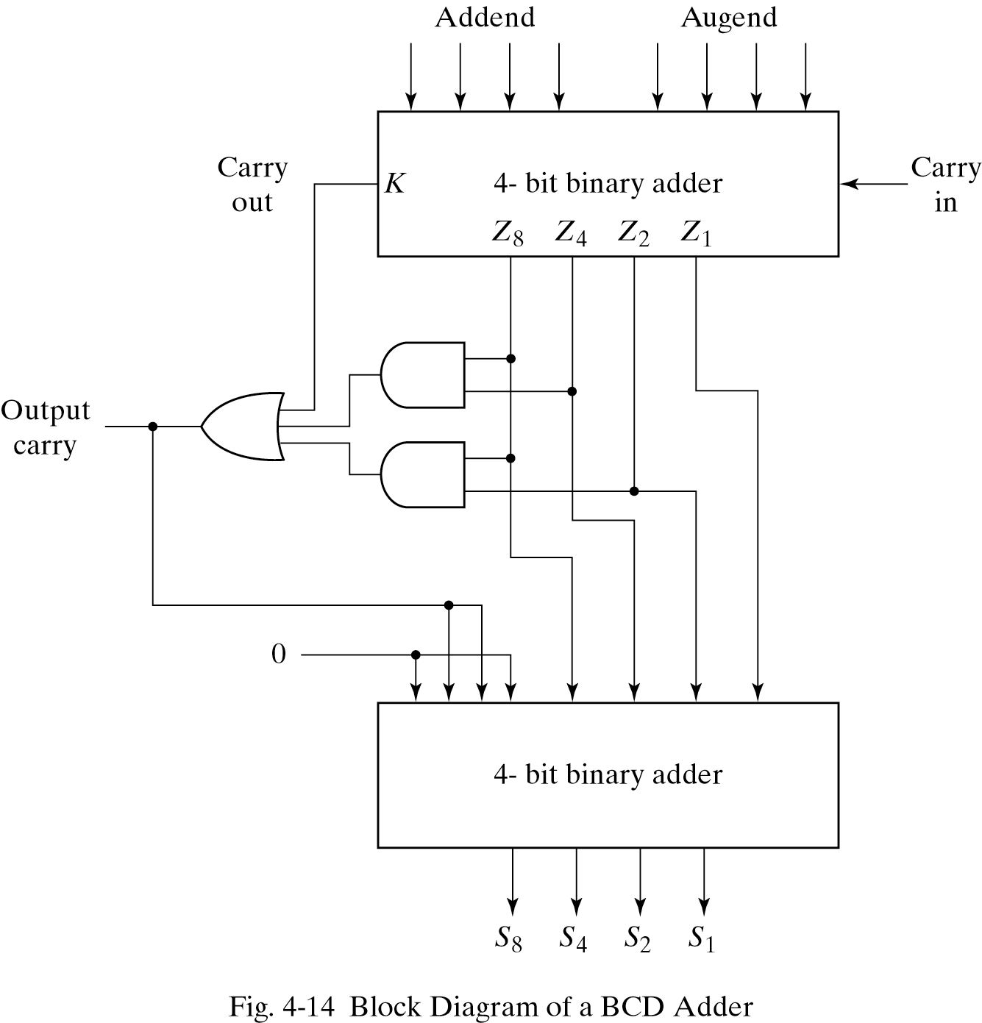
BCD Adder
Numbers that need correction (add 6) are:
01010 (10)
01011 (11)
01100 (12)
01101 (13)
01110 (14)
01111 (15)
10000 (16)
10001 (17)
10010 (18)
10011 (19)
Decides to add 6?
Adds 6

Slide 16
BCD Adder
Numbers that need correction (add 6) are:
K Z8 Z4 Z2 Z1
0 1 0 1 0 (10)
0 1 0 1 1 (11)
0 1 1 0 0 (12)
0 1 1 0 1 (13)
0 1 1 1 0 (14)
0 1 1 1 1 (15)
1 0 0 0 0 (16)
1 0 0 0 1 (17)
1 0 0 1 0 (18)
1 0 0 1 1 (19)
C = K + Z8Z4 +Z8Z2

Slide 17
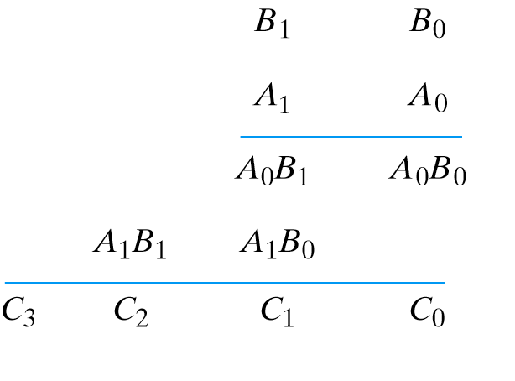
Binary Multiplier
Multiplication of binary numbers is done in the same way as decimal numbers
Multiplicand B is multiplied by the multiplier A starting from the LSB.
Successive partial products are shifted one position from the left and the final product is obtained from the sum of partial products.

Slide 18
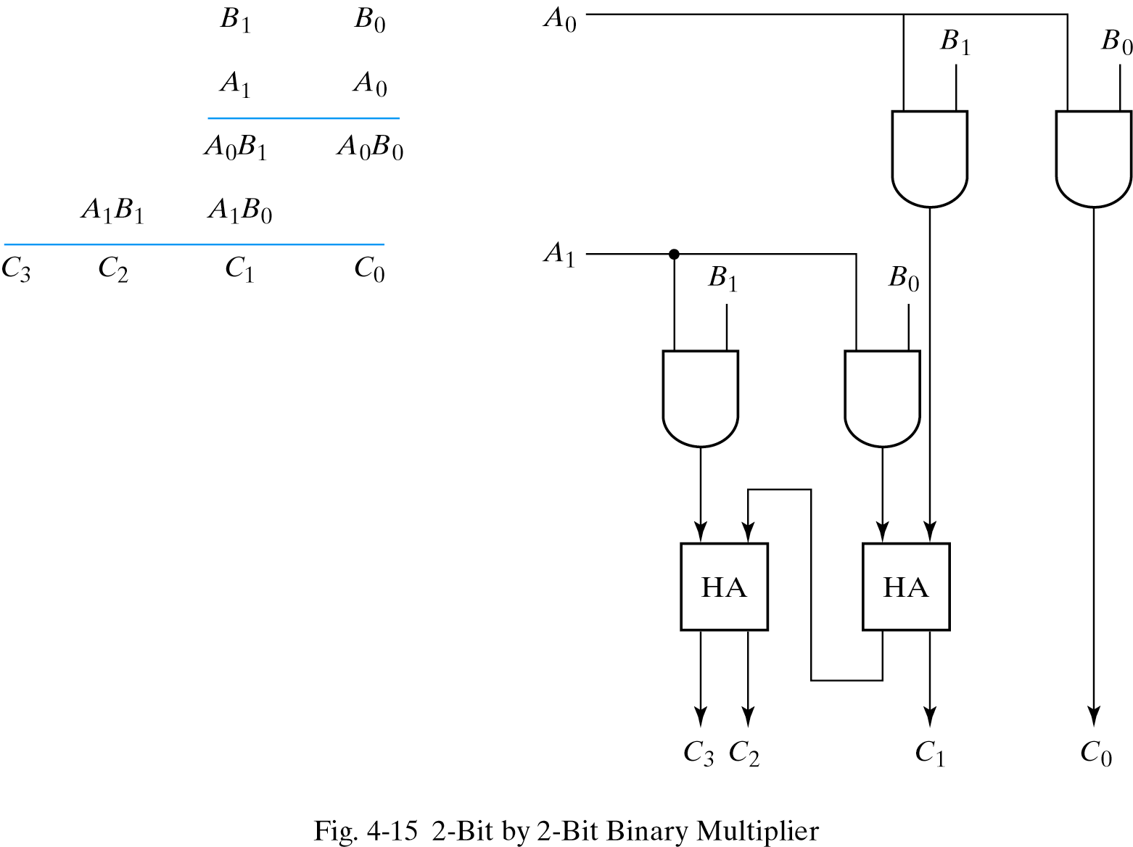
Binary Multiplier
2-Bit by 2-Bit Binary Multiplier

Slide 19
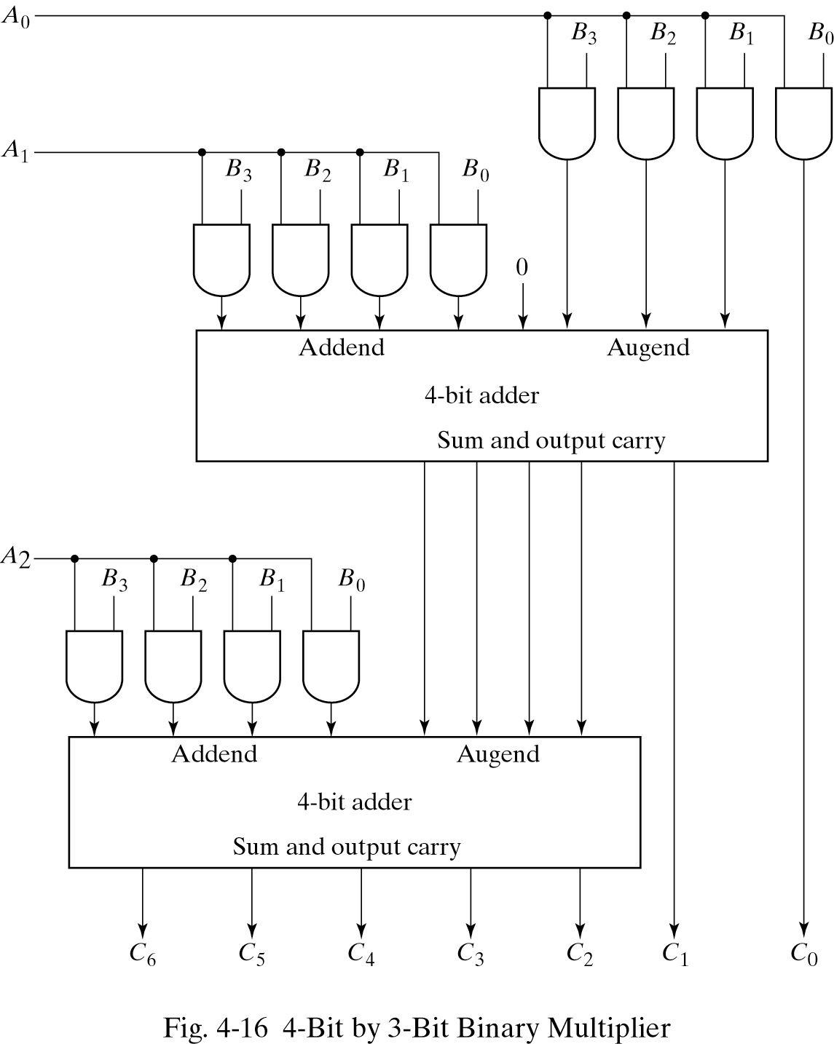
Binary Multiplier
4-Bit by 3-Bit Binary Multiplier
B3 B2 B1 B0
A2 A1 A0
A0B3 A0B2 A0B1 A0B0
A1B3 A1B2 A1B1 A1B0
A2B3 A2B2 A2B1 A2B0
B3 B2 B1 B0
A2 A1 A0
A0B3 A0B2 A0B1 A0B0
A1B3 A1B2 A1B1 A1B0
A2B3 A2B2 A2B1 A2B0
J x K
J x K AND gates
(J-1) K-bit adders
Result: J + K bits

Slide 20
Practice Exercises
Design a 3-bit by 4-bit multiplier
Design a 4-bit by 4-bit multiplier

Slide 21
Magnitude Comparator
Definition: A magnitude comparator is a combinational circuit that compares two numbers A & B to determine whether:
  A > B, or
  A = B, or
  A < B
Inputs
  First n-bit number A
  Second n-bit number B
Outputs
  3 output signals (GT, EQ, LT), where:
    GT = 1 IFF A > B
    EQ = 1 IFF A = B
    LT = 1 IFF A < B
n-bit input
n-bit magnitude
comparator
GT
A
EQ
n-bit input
B
LE
Note: Exactly One of these 3 outputs equals 1, while the other 2 outputs are 0`s

Slide 22
Magnitude Comparator (4 bit)
Problem: Design a magnitude comparator that compares two 4-bit numbers A and B and determines whether:
  A > B, or
  A = B, or
  A < B
4-bit input
4-bit magnitude
comparator
GT
A
EQ
4-bit input
B
LE

Slide 23
Magnitude Comparator (4 bit)
Inputs: 8-bits (A ⇒ 4-bits , B ⇒ 4-bits)
  A and B are two 4-bit numbers
Let A = A₃A₂A₁A₀ , and
Let B = B₃B₂B₁B₀
Inputs have 2⁸ (256) possible combinations (size of truth table and K-map?)
Not easy to design using conventional techniques
4-bit input
4-bit magnitude
comparator
GT
A
EQ
4-bit input
B
LE
The circuit possesses certain amount of regularity
⇒ can be designed algorithmically.

Slide 24
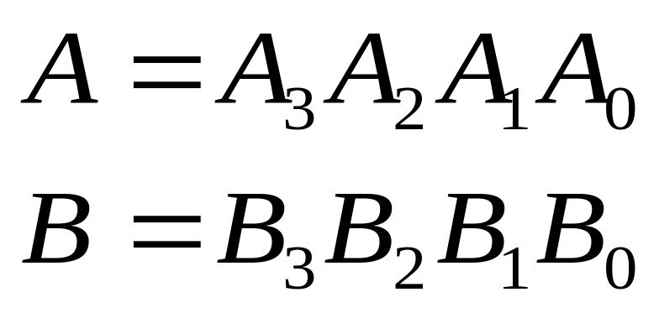

Magnitude Comparator (4 bit)
Designing EQ
Can you think of an operator which is 1 when both inputs are 1 or both inputs are 0
XNOR

Slide 25
Magnitude Comparator (4 bit)
Designing EQ
Define X_{i} = A_{i} XNOR B_{i} ; A_{i} B_{i} + A_{i}’ B_{i}’
  ➔ X_{i} = 1 IFF A_{i} = B_{i} ∀ i =0, 1, 2 and 3
  ➔ X_{i} = 0 IFF A_{i} ≠ B_{i}
Therefore the condition for A = B or EQ=1 IFF
  A₃= B₃ → (X₃ = 1), and
  A₂= B₂ → (X₂ = 1), and
  A₁= B₁ → (X₁ = 1), and
  A₀= B₀ → (X₀ = 1).
Thus, EQ=1 IFF X₃ X₂ X₁ X₀ = 1. In other words,
EQ = X₃ X₂ X₁ X₀

Slide 26
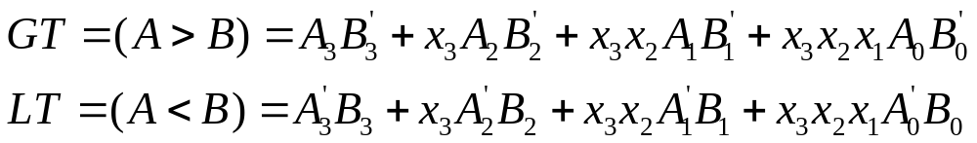
Magnitude Comparator (4 bit)
Designing LT & GT
GT = 1 if A > B:
  If A₃ > B₃ → A₃ = 1 and B₃ = 0
  If A₃ = B₃ and A₂ > B₂
  If A₃ = B₃ and A₂ = B₂ and A₁ > A₁
  If A₃ = B₃ and A₂ = B₂ and A₁ = B₁ and A₀ > B₀
Compare:

Slide 27
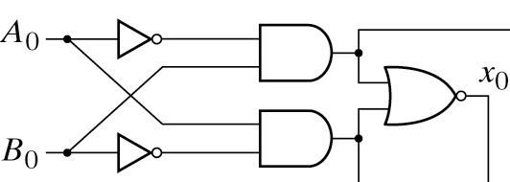
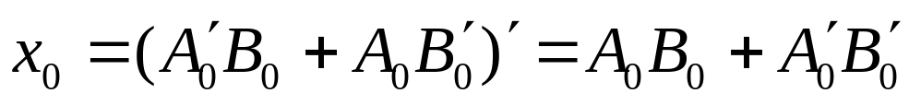
Magnitude Comparator (4 bit)
XNOR

Slide 28
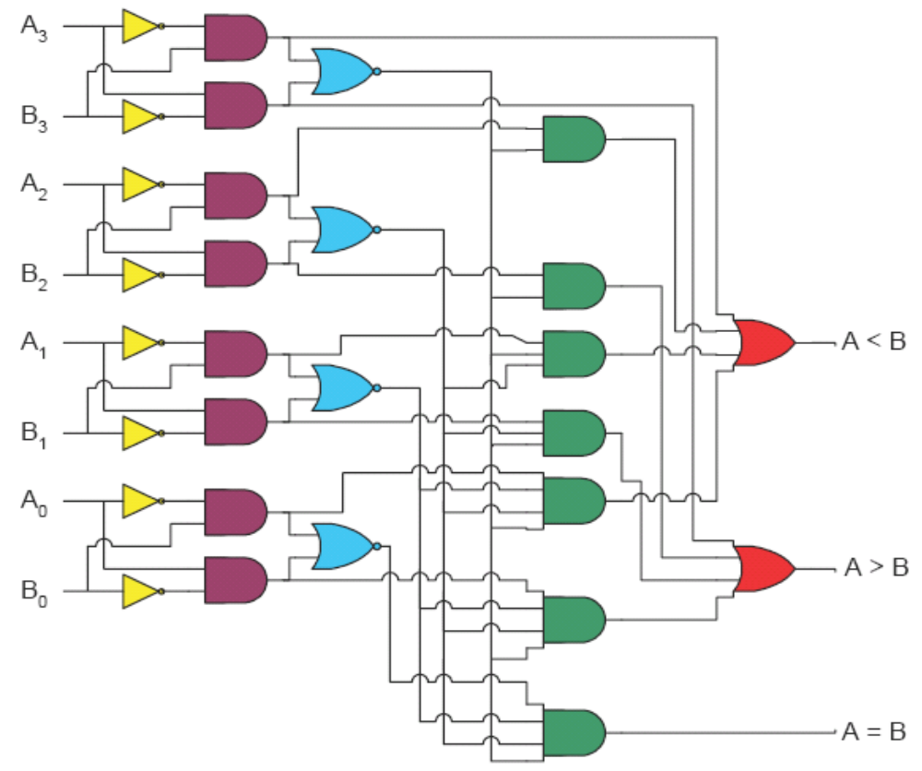
Magnitude Comparator (4 bit)
EQ = X₃ X₂ X₁ X₀
GT = A₃B₃’
+ X₃A₂B₂’
+ X₃X₂A₁B₁’
+ X₃X₂X₁A₀B₀’
LT = B₃A₃’
+ X₃B₂A₂’
+ X₃X₂B₁A₁’
+ X₃X₂X₁B₀A₀’

Slide 29
Magnitude Comparator (4 bit)
EQ = X₃ X₂ X₁ X₀
GT = A₃B₃’
+ X₃A₂B₂’
+ X₃X₂A₁B₁’
+ X₃X₂X₁A₀B₀’
LT = B₃A₃’
+ X₃B₂A₂’
+ X₃X₂B₁A₁’
+ X₃X₂X₁B₀A₀’

Slide 30
References
Chapter 4 – Digital Design Morris Mano
Logic and Computer Design Fundamentals, 4e, Power Point Slides, 2008 Pearson Education Inc.
Digital Design – Amirali Baniasadi
Material in these slides has been taken from, the following resources

